Slide 1
ctcLink
Activation, Entering Time & Approving Time
February 2022
Amy Rovner & Christie Fierro

Slide 2

Outcomes for Today
By the end of this session, you will be able to:
Describe how to Activate your ctcLink Account
Find the Time Tile and enter time
Supervisors will know how to Approve Time

Slide 3

ctcLink ID!
IMPORTANT!
In a few steps, you will see your ctcLink ID.
Before you fly ahead….
Make sure to write down/take photo of your ctcLink ID, then click OK.
https://support.shoreline.edu/hc/en-us/articles/4412681828759-How-do-faculty-activate-their-ctcLink-account-
This Photo by Unknown Author is licensed under CC BY-SA

Slide 4
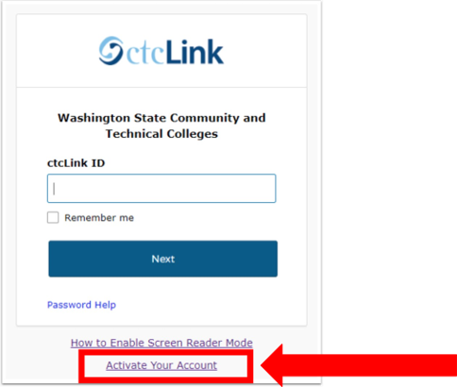
Activating Your Account
Shoreline ctcLink Go-Live
Monday, February 28, 2022​
Employee Account Activation
  Monday, February 28, 2022​
Student Account Activation
  Monday, March 7, 2022​
One ctcLink ID for employees and students across all 34 colleges

Slide 5
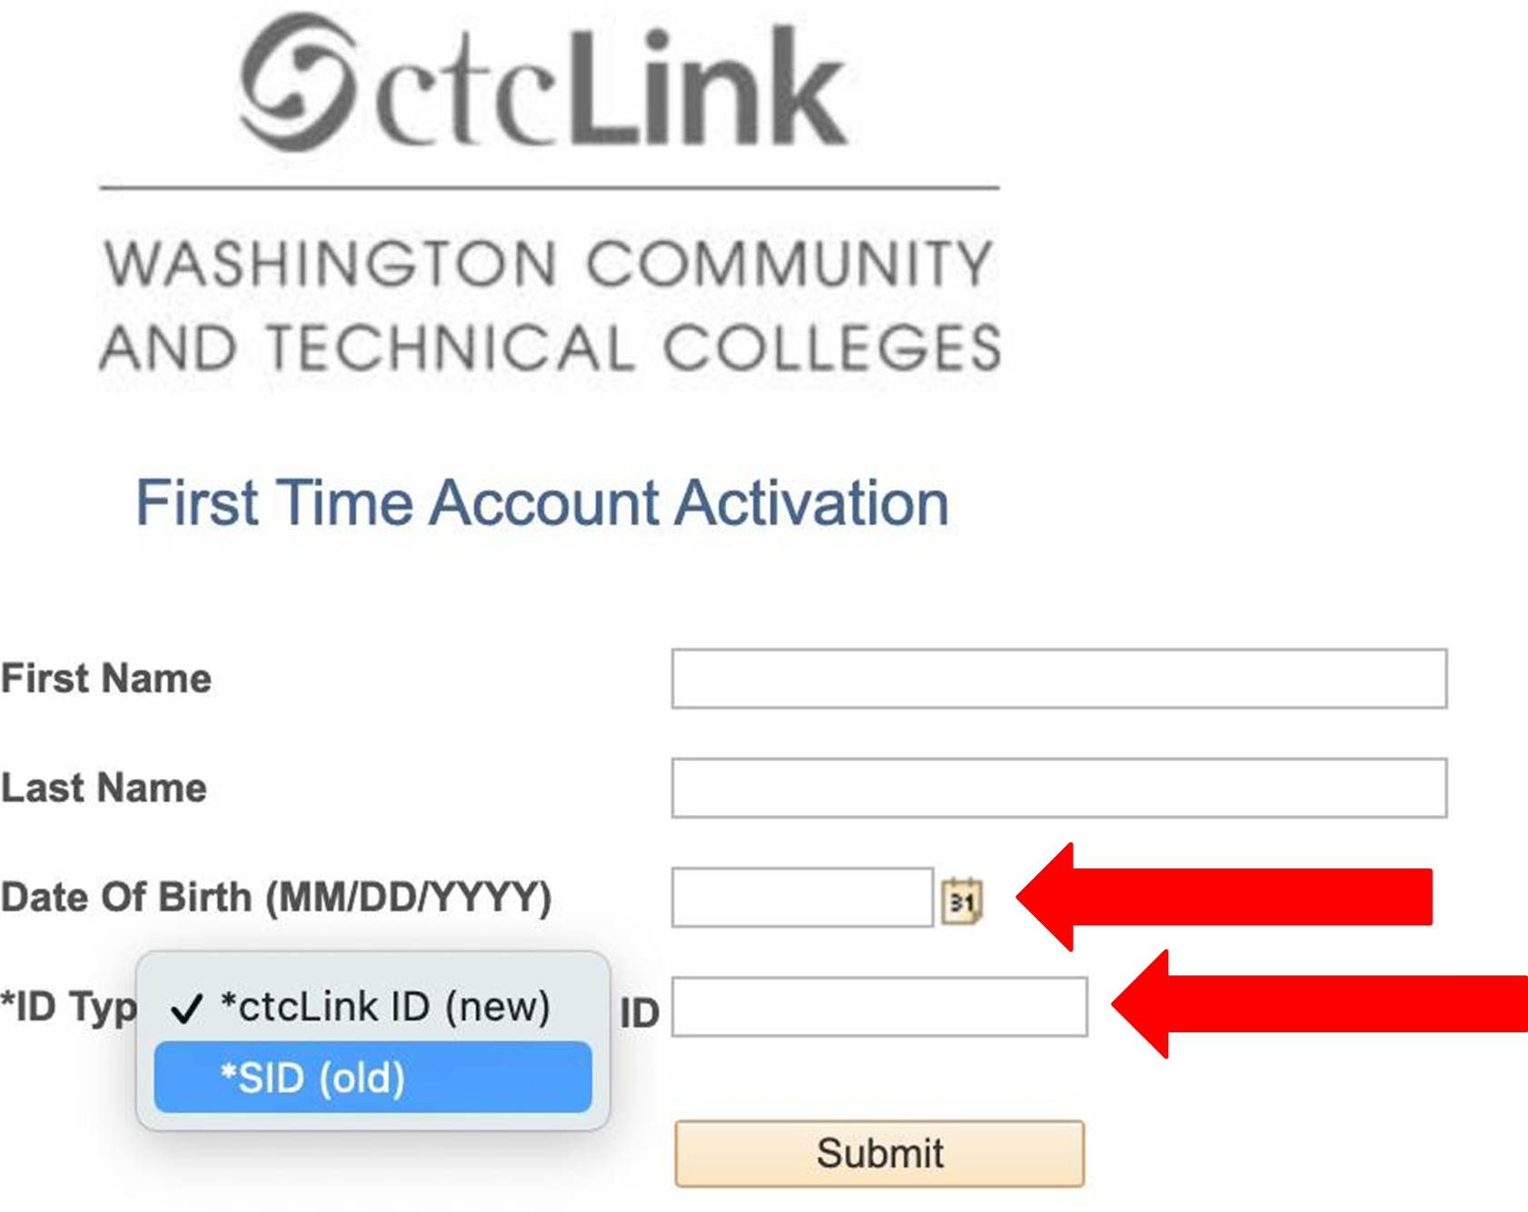
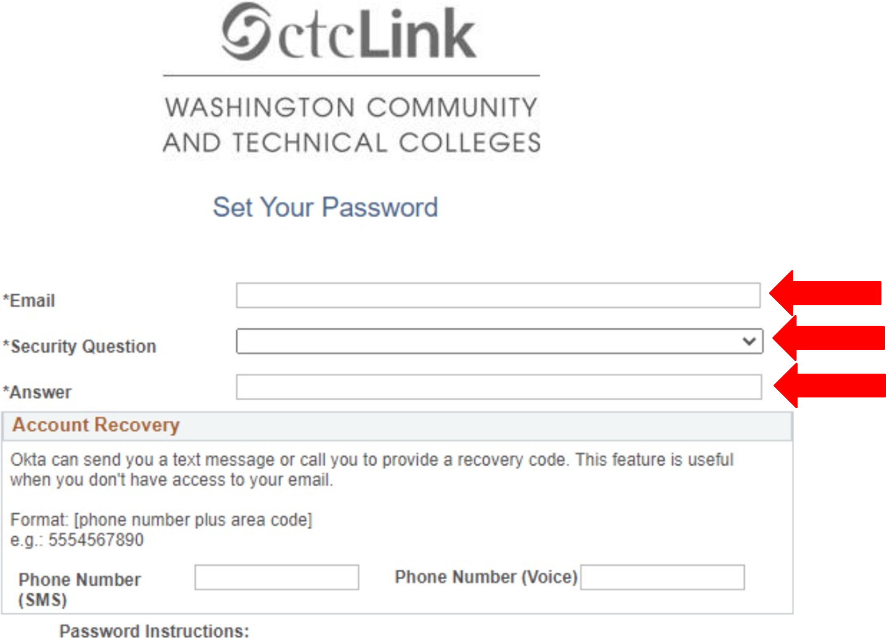
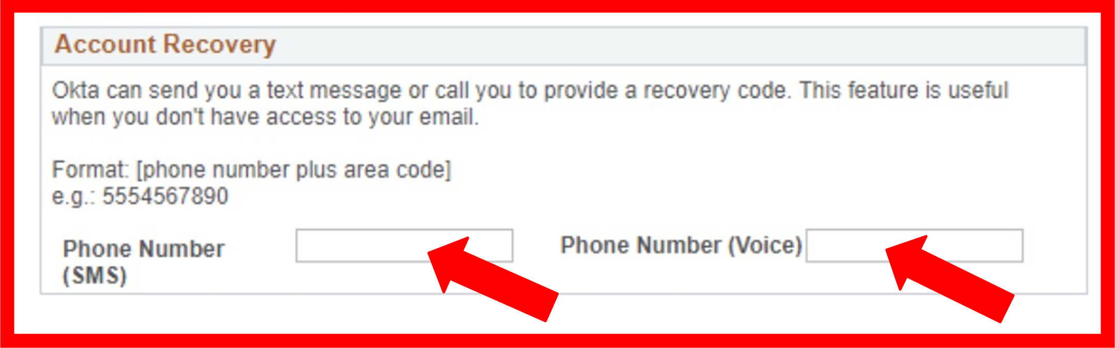
Enter Requested Information

Slide 6
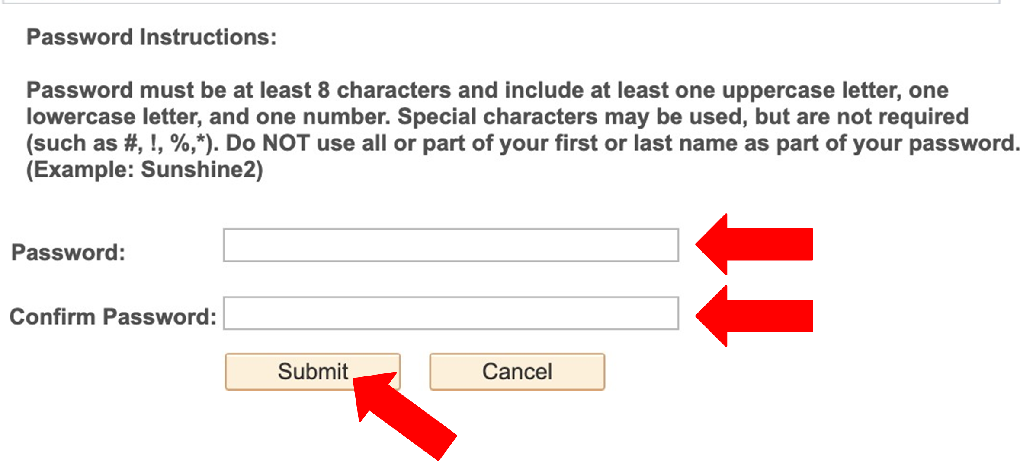
Create Password
Password must have:
At least 8 characters
1 UPPERCASE letter
1 lowercase letter
1 number (0, 1, 2, 3 . . . )
https://support.shoreline.edu/hc/en-us/articles/4412681828759-How-do-faculty-activate-their-ctcLink-account-

Slide 7
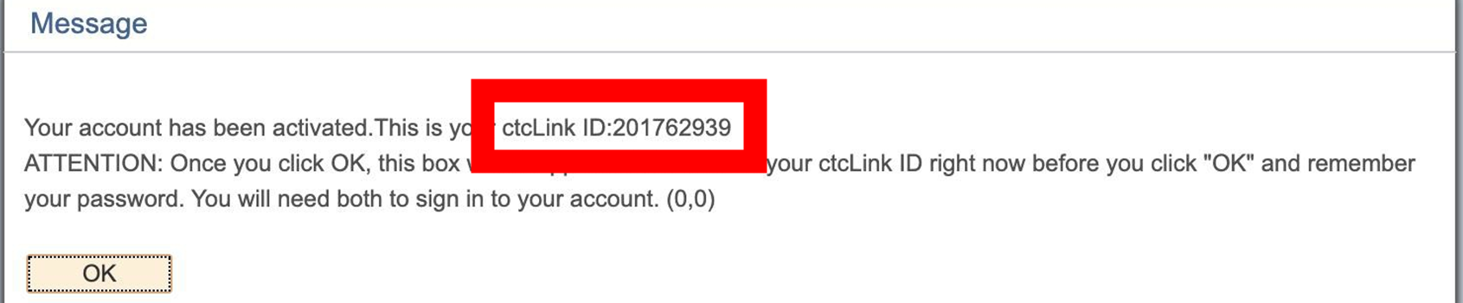
ctcLink ID!
IMPORTANT!
Make sure to write down/take photo of your ctcLink ID, then click OK.
https://support.shoreline.edu/hc/en-us/articles/4412681828759-How-do-faculty-activate-their-ctcLink-account-
This Photo by Unknown Author is licensed under CC BY-SA

Slide 8
Access in ctcLink
Access to content in ctcLink is customized based on your roles & tasks
Your Tiles may look different than someone else’s tiles
You will only see and be able to edit tiles, pages and areas that you have been granted security access to

Slide 9
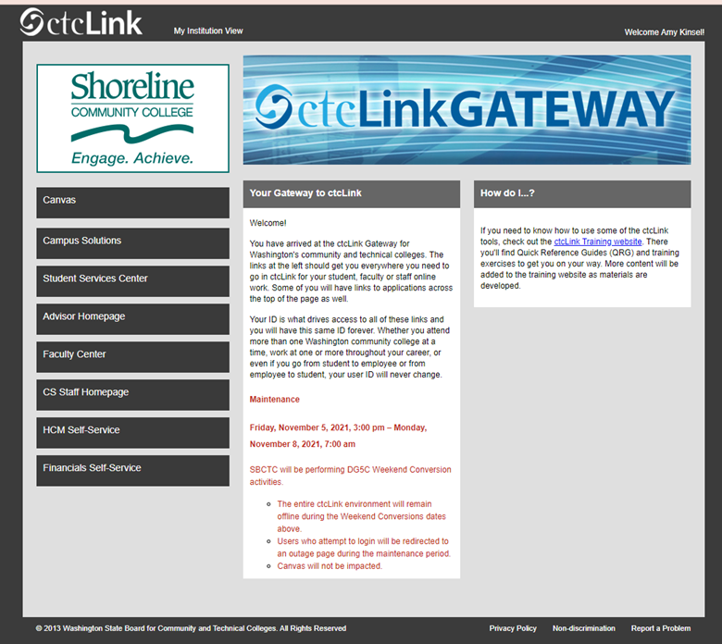
Opens to Gateway
Find HCM Self-Service Button
Employee Self Service

Slide 10
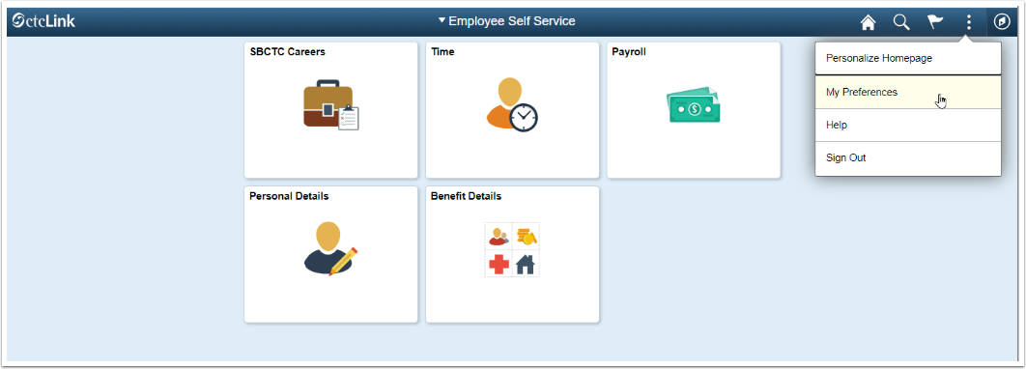
Employee Self-Service Tiles

Slide 11
Time Tile
Time Tile Includes:
Time Reporting – Regular, Comp and Absences
Manage Exceptions (Errors)
Request Overtime & Absences
View Requests and Balances
Notes:
Careers – replaces NeoGov
Time – time reporting, leave balances, leave requests, leave reporting
Payroll – direct deposit, paycheck information, tax withholding, earning statements, W-2s
Benefit Details – medical, dental, disability, retirement

Slide 12
How do I Report My Time?
Classified and Hourly Staff use Enter Time
  Time entered per time period
  Prescheduled
Anyone using Assistive Technology use Report Time
There are Time Reporting Codes (TRC) for comp time

Slide 13
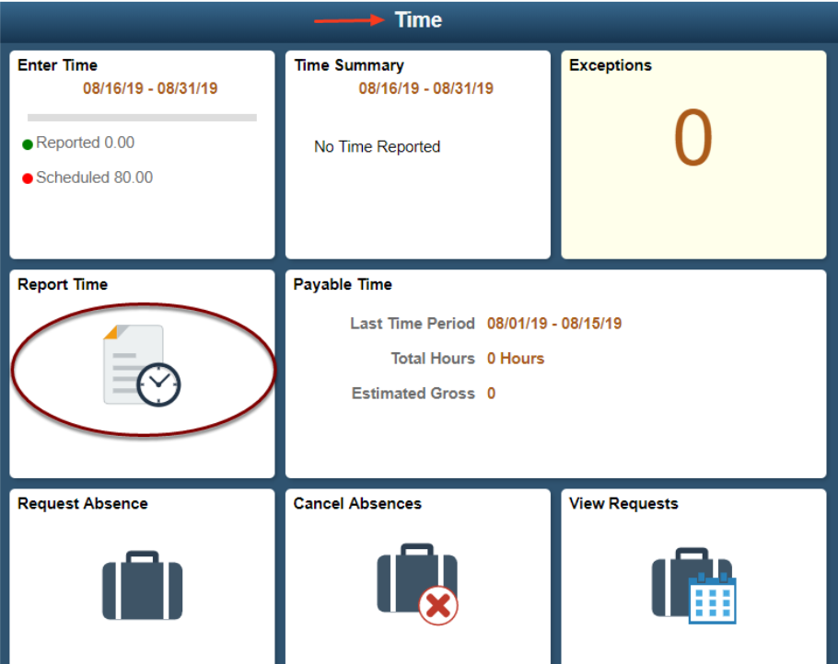
Time Tile Options
Only use Report Time if you are using assistive technology.

Slide 14
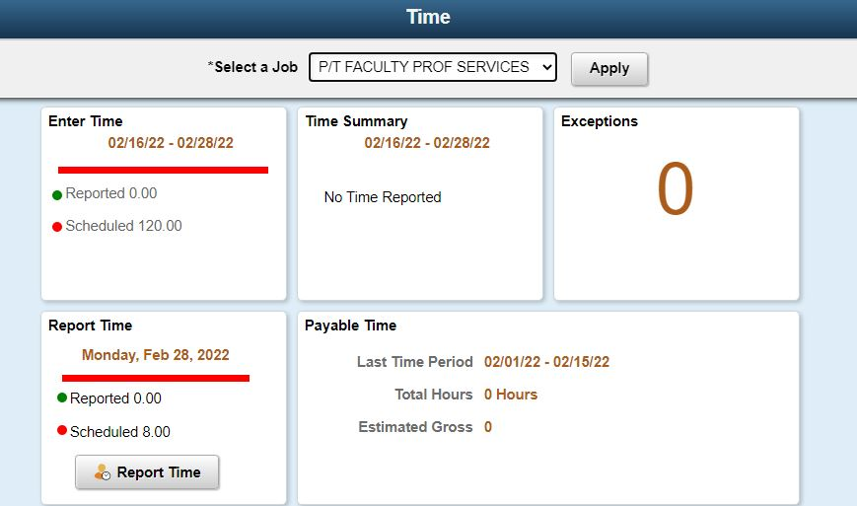
How to Use “Enter Time”
If you have more than one role, there will be a drop down to select the appropriate role you are entering time for.
Notes:
Some hourly employees may have more than one job. If you have more than one job, you have a couple of tile options for time reporting. If you find it difficult to report time for multiple jobs using the Enter Time tile, try using the CTC Time tile. Instructions are found later.

Slide 15
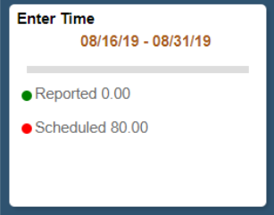
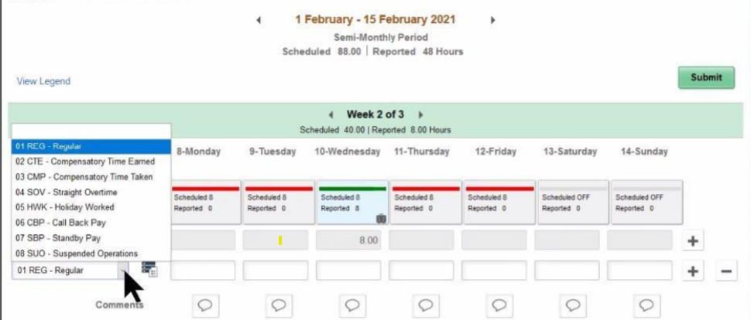
How to Use “Enter Time”
Classified & Hourly Staff
Time Reporting Codes (TRC)
Notes:
For employees paid by the hour, all days in the pay period are displayed on one page. The top of the page displays the current pay period. You can switch to view a different pay period using the arrow buttons to the left or right. There is a View Legend link at the top of the page that gives additional details about information that can be seen on the screen. • If you have time to report for a pay period that has already passed, you will need to work with HR/Payroll

Slide 16
How to Use “Enter Time”
Classified & Hourly Staff
Time Reporting Codes (TRC)
Notes:
Your default schedule will display with the scheduled number of hours on each day.
. Days without time reported will display a red bar. When time is reported, the bar will turn green.
. If reported hours are less than the scheduled hours for a day, a portion of the bar will display green, and the remainder will display red.
. We going to cover requesting absences in Friday’s session. If you report an absence (due to vacation, illness, etc.), it must be requested and approved by your manager using the Request Absence tile. (Managers are often referred to as “supervisors” documents, such as contracts.) After approved by your manager, your absence will display automatically in a separate (grayed out) row on the Enter Time page. In the example below, the absence is shown as CSL - Compensable Sick Leave.
f Comp Time was earned in the period:
Select the (+) on the right hand side of the screen to add a row.
Select CTE from the TRC drop-down on the left.
Enter the number of hours to accrue under CTE.
Select Submit and OK.
If Comp Time was taken in the period:
Select the (+) on the right hand side of the screen to add a row.
Select CMP from the TRC drop-down on the left.
Enter the number of hours used under CMP.

Slide 17
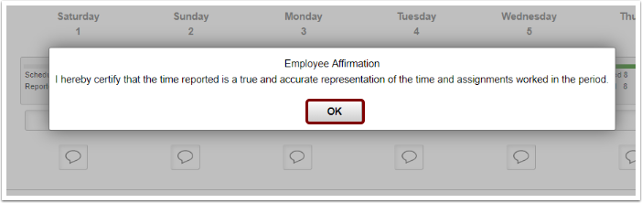
How to Use “Enter Time”
Classified & Hourly Staff
After you select Submit, an Employee Affirmation message displays

Slide 18
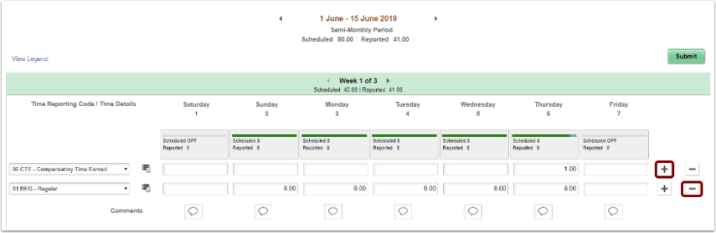
How to Use “Enter Time”
Use the plus if you need to add a row (for example, if you need to add time with a different Time Reporting Code (TRC)
Use the minus to remove a row if you need to delete it.
Notes:
If time needs to be changed: e nter a new hour value under the relevant day and then s elect Submit and OK.
If a TRC needs to be removed from the timesheet:
Select the (-) on the right hand side of the screen to remove a row.
The system will prompt a question, select either Yes Delete or No Do Not Delete.
If Yes Delete was chosen and the employee wishes to finalize their choice, select Submit and OK.
If a Comment is needed select the comment box below the day in which a comment is needed, type in text, and select Add Comment.
Comments, once entered, cannot be altered or removed. Additionally, all comments recorded by employees are considered discoverable.
NOTE: Time is processed periodically, but at minimum overnight. Time entered may not be visible to the employee or manager in other screens until the overnight processing has occurred.

Slide 19
How to Use “Enter Time”
There is a comment box if a comment is needed.
Comments, once entered cannot be altered or deleted.
All employee comments are considered discoverable.

Slide 20
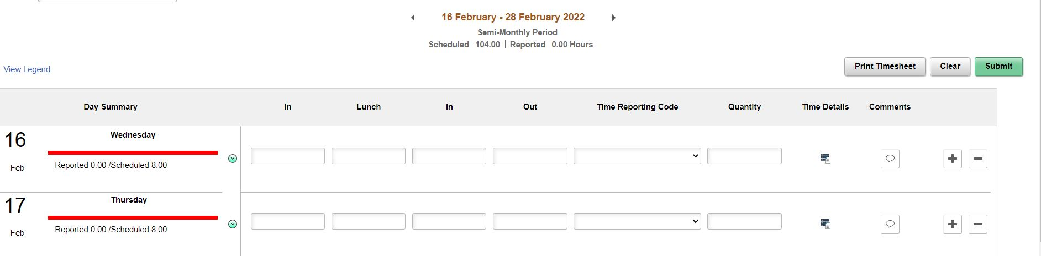
How to Use “Enter Time”
If you are an hourly employee with a lunch break, enter time in the following pattern:
In – what time you started work for the day
Lunch – time you left for your break
In (from lunch) – time you returned to work
Out – time you finished work for the day

Slide 21
How to Use “Enter Time”
If you do not have a lunch break, enter time in the following pattern:
In – what time you started work for the day
Out – time you finished work for the day

Slide 22
How to Use “Enter Time”
If there is a large break in the day, this is not a lunch break.
On the first row, enter your In and Out times.
Select the + and add a row.
Enter the additional In and Out times.

Slide 23
How to Use “Enter Time”
IMPORTANT: Make sure you report the time you ended work in the Out field. If you use the lunch field, the system will think you are aon a break and not that your work was completed for the day. This will cause time reporting errors.

Slide 24
How to Use “Enter Time”
Time is assumed to be 24 time if no AM or PM entry is indicated.
• For example, 8:00 AM can be entered as either 8 or 8AM in the timesheet.
• For example, 2:00 PM can be entered as either 14 or 2PM in the timesheet (i.e. if 2 is entered without the PM then the system will assume that means 2AM)

Slide 25
How to Use “Enter Time”
Click Submit after you have entered time. If you add time and try to move to another page before clicking Submit, you will see an error message.

Slide 26
How to Use “Enter Time”
When time is submitted, it will be processed by the system overnight, and your manager will receive a request to approve in the system.
Before the payroll deadline, you can update and resubmit your timesheet. Managers only need to approve once at the end of the pay period.
Around the end of the pay period, HR and Payroll may run the overnight process during the day so that managers receive notification on the same day that the timesheet is submitted

Slide 27
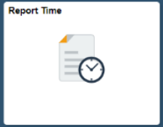

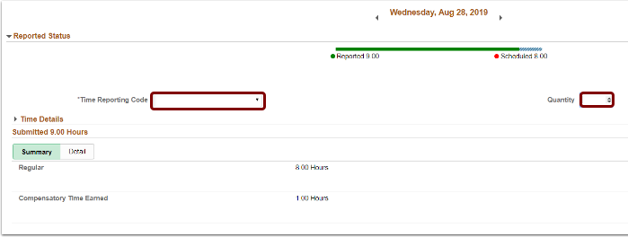
“Report Time”
Do not use the Report Time tile unless you are
using assistive technology.
Notes:
Detailed Steps:
The Report Time page displays.
Select a Job at top from the drop-down menu if user has more than one job.
Select a Time Reporting Code (TRC) from the drop-down menu on the left.
Enter the number of hours in Quantity. (Partial hours must be represented in the decimal, for instance eight and a half hours would be 8.5).
Select the Submit button.
Select OK to acknowledge the affirmation statement.
Time will be processed periodically and sent to the employee’s manager for approval (if it is a TRC that needs approval).
If an additional TRC was worked in the period:
Select the TRC on the left side of the screen.
Enter the number of hours worked on the new TRC in Quantity.
Select Submit and OK.
If Comp Time was earned in the period:
Select Compensatory Time Earned from the TRC drop-down menu on the left.
Enter the number of hours to accrue under CTE in Quantity.
Select Submit and OK.
If Comp Time was taken in the period:
Select Compensatory Time Taken from the TRC drop-down menu on the left.
Enter the number of hours used under CMP in Quantity.
Select Submit and OK.
If time needs to be changed:
Select the correct Day at the top.
Select the TRC under the Summary/Detail tabs.
Enter a new hour value in Quantity.
Select Submit and OK.
If a TRC needs to be removed from the timesheet:
Select the correct Day at the top.
Select the TRC under the Summary/Detail tabs.
Select Delete at the bottom of the page.

Slide 28
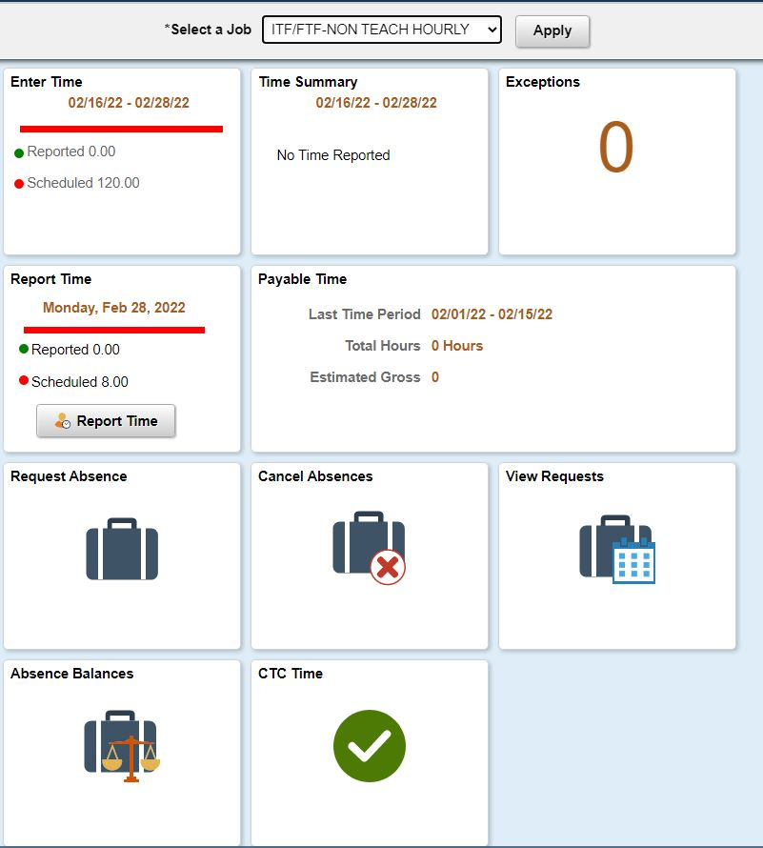
Entering time for Multiple Jobs
Notes:
For employees with more than one job, the CTC Time is an alternative option for reporting hours on multiple jobs. See below for instructions for using the CTC Time tile. Talk to your supervisor to make sure you are entering time for the correct job. When you are in the “Time” tile, you will click on "CTC Time.

Slide 29
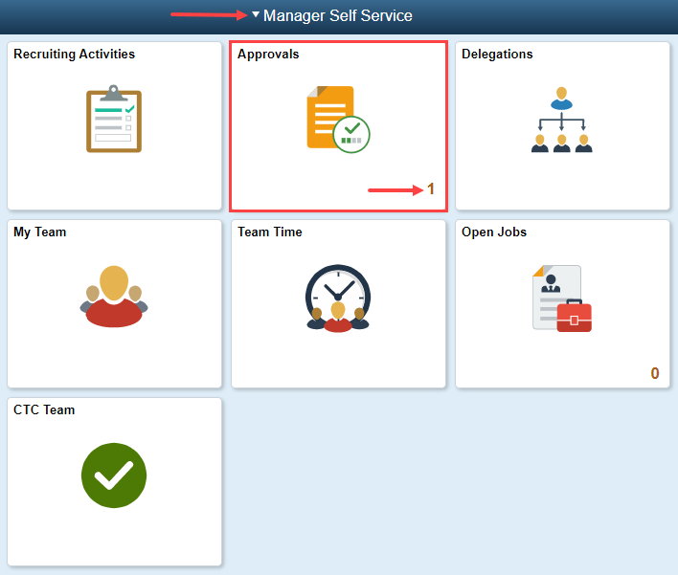
Supervisors Approve Time
Notes:
To review any pending approvals that need your attention, begin by selecting the Approvals tile, from the Manager Self Service homepage. If there are pending approvals, a corresponding number will show in the bottom right corner of the Approvals tile. If there are no pending approvals, a "0" will display.

Slide 30
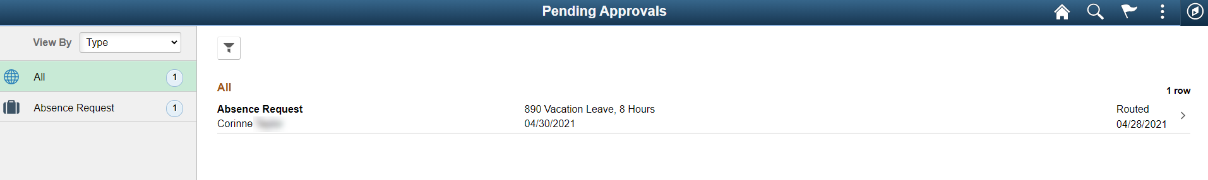
Reviewing Pending Approvals
Notes:
The Pending Approvals page displays a list of pending approval requests such as absence requests, payable time requests, overtime requests etc., for review. Once the pending items are reviewed, appropriate action - approval, denial or pushback - must be taken.
The next example shows one pending item, an absence request, in need of approval.

Slide 31
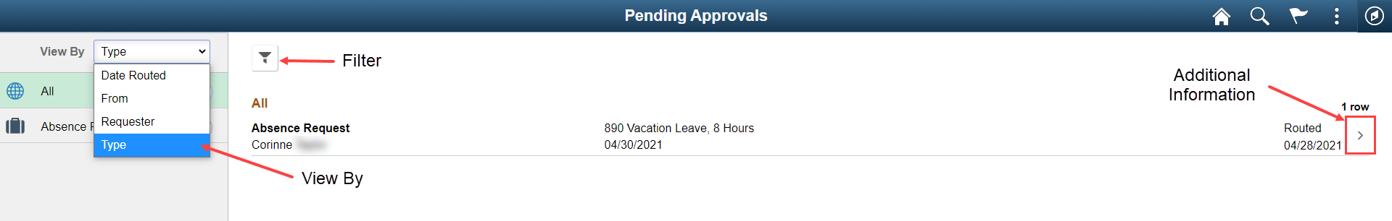
Notes:
Notice that you have the ability to view pending approvals by Date Routed, From, Priority, Requester or Type. The filter button is available if multiple pending approvals are listed. To view additional request information, select the appropriate transaction or row.

Slide 32
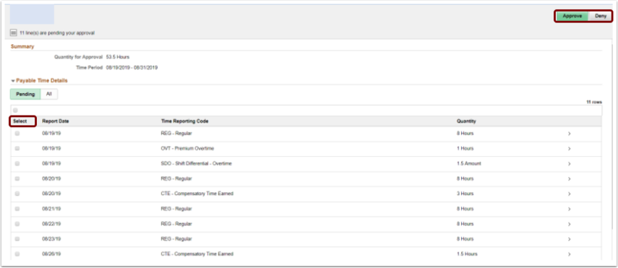
Approving Time
Notes:
If using the Payable Time section of the Pending Approvals page, select the appropriate transaction row(s) for the employee(s) requesting payable time approval, enter a comment in the Approver Comments field if desired and then approve or deny the request using the Approve or Deny buttons in the upper right hand corner of the page.

Slide 33
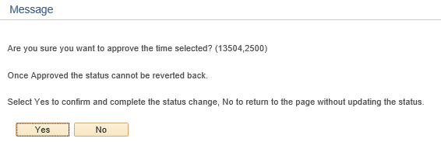
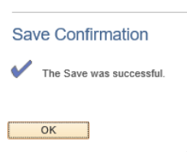
Approving Time
Notes:
A message box will display asking for confirmation of approval for the time selected. Select Yes to confirm and complete the status change or select No to return to the page without updating the status. A save confirmation message will display stating the approval was successful.
A message will be sent to the employee informing them of the action taken by the manager.

Slide 34
Need Support? We got you!
Shoreline Technical Support Center
  Self Service info at your fingertips!
Shoreline ctcLink Web Pages
  Overview of project, updates and calendar of events
Employee Navigation Paths in ctcLink
ctcLink Reference Center
  Sleuth out the answer

Slide 35
Questions?
Thank you!

